Slide 1
GaianDB Asset Training Day
David Vyvyan,
Paul Stone,
Patrick Dantressangle
Big Data VTIs – MongoDB and Accumulo
IBM Confidential

Slide 2
Big Data VTI Features
Installation of Big Data Extensions
MongoDB VTI
  Gaian Nodes will discover and connect to other nodes to form a network.
Accumulo VTI
  Data sources available to one node can be accessed by all in the network.
Worked Examples

Slide 3

Big Data Extensions
Installation

Slide 4
Big Data VTI Features Installation
Please refer to GAIAN_BIG_DATA_EXTENSIONS.zip/Readme.html for detailed Installation instructions
There are a number of prerequisite Java Archives (JARs) for Mongo and Accumulo. These need to be downloaded and copied into the GaianDB Installation directory
Unzipping the GAIAN_BIG_DATA_EXTENSIONS.zip file into the GaianDB Installation directory, all files will be placed in the correct locations.
If using the setltforMongodb or setltforAccumulo stored procedures, run the registerMongoandAccumuloProcedures script.

Slide 5
Gaian Database Asset
Mongo VTI User Overview

Slide 6
MongoDB Data Model to Logical Table Mapping
A MongoDB database contains a set of "collections", each collection contains a set of "documents" each document has a set of fields.
When mapping to a Gaian Logical Table, a mongo collection is equivalent to a "table", a mongo document is equivalent to a "row" and a field is equivalent to a column in a row.
Query From Mongo Shell:
[root@ets01 ~]# mongo
MongoDB shell version: 2.4.9
connecting to: test
> use bikes
switched to db bikes
> db.south.find()
{ "_id" : ObjectId("5321a49563dba726aac257f4"), "id" : 440, "stationName" : "Kennington Oval", "areaName" : "Oval", <br> "lat" : 51.483145, "lon" : -0.113134, "nbBikes" : 11, "nbEmptyDocks" : 22, "installed" : "TRUE", "locked" : "FALSE", "temporary" : "FALSE" }
{ "_id" : ObjectId("5321a49563dba726aac257f5"), "id" : 291, "stationName" : "Claverton Street", "areaName" : "Pimlico", <br> "lat" : 51.48483991, "lon" : -0.138089062, "nbBikes" : 24, "nbEmptyDocks" : 7, "installed" : "TRUE", "locked" : "FALSE", "temporary" : "FALSE" }
{ "_id" : ObjectId("5321a49563dba726aac257f6"), "id" : 245, "stationName" : "Grosvenor Road", "areaName" : "Pimlico", <br> "lat" : 51.4853572, "lon" : -0.142207481, "nbBikes" : 15, "nbEmptyDocks" : 11, "installed" : "TRUE", "locked" : "FALSE", "temporary" : "FALSE" }
{..
Query to the same mongo collection using a Gaian Logical Table and the MongoDB VTI:
Connecting to derby database: jdbc:derby://localhost:6414/gaiandb;create=false, usr: gaiandb...
sql> select * from bikes_m_s
select * from bikes_m_s
======================================================================================================================================
_ID |ID |STATIONNAME |AREANAME |LAT |LON |NBBIKES |NBEMPTYDOCKS|INSTALLED|LOCKED|TEMPORARY|
======================================================================================================================================
5321a49563dba726aac257f4| 440|Kennington Oval |Oval |51.483145 |-0.113134 | 11| 22|true |false |false |
5321a49563dba726aac257f5| 291|Claverton Street |Pimlico |51.48483991 |-0.138089062 | 24| 7|true |false |false |
5321a49563dba726aac257f6| 245|Grosvenor Road |Pimlico |51.4853572 |-0.142207481 | 15| 11|true |false |false |
...
======================================================================================================================================

Slide 7
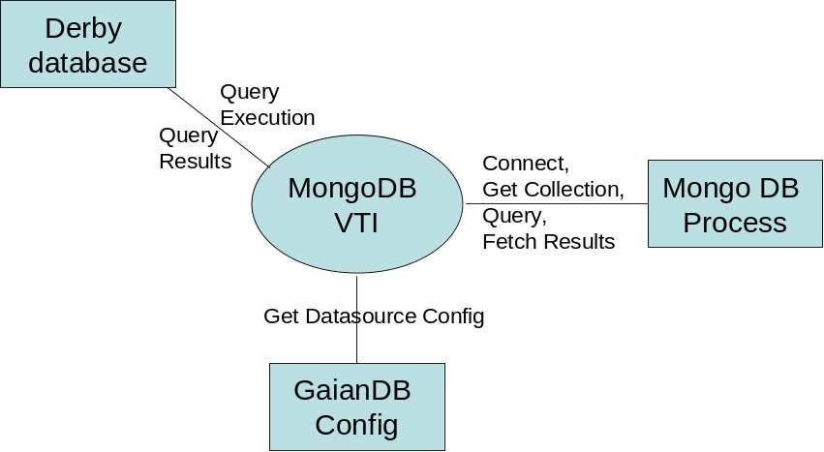
Gaian Asset MongoDB VTI
Implemented and tested using MongoDB (2.4.9) released on 1/10/2014.
Mongo User Documentation available here: http://www.mongodb.org/
Implemented:
End point authentication (static-configured)
Passing all qualifiers (mapped to mongo operators)
Support for types
  integer, double, text, boolean, Date, time,
Stored Procedure “setltforMongodb” for easy configuration
Selective fetching of LT and Query columns from Mongo
Not implemented
Caching results
Advanced parsing of complex json types such as arrays
Advanced support for aggregate operators (count *, max, min) - these will work, but will be sub-optimal.
Support for passing statistics to derby (EstimatedRowCount and costPerInstantiation) not provided.
Design Decisions
Use Java API (not REST) (http://api.mongodb.org/java/current/index.html)
Only support for querying, not updates or inserts.

Slide 8
setltformongoDB stored procedure
Procedure Syntax
  call Setltformongodb (‘{logical table name}‘ , ‘{user}:{password}@{mongo host address}:{mongo port}/{database}/{collection}‘ , ‘{optional list of columns}')
  The procedure will create a logical table definition for the names table, using the specified mongo database/collection as a datasource.
  User and password are optional and should be omitted for unsecured mongo databases.
  If a list of columns if provided, the query will only retrieve these columns. If no columns are provided, the schema is derived from the first row retrieved from the collection.
Authentication user/password provided
  call Setltformongodb (‘LTCE‘ , ‘myuser:password01@ets01.hursley.ibm.com:27017/ce/sentences‘ , '')
No authentication, columns of interest are provided
  call setltformongodb('bikes_m_n', 'ets01.hursley.ibm.com:27018/bikes/north', 'id, stationName, areaName, lat, lon‘)
Execution of this procedure will generate configuration in the config file. This may then be modified by hand for fine tuning parameters
The procedure must be registered before it can be used:
  CREATE PROCEDURE setltformongodb(LTNAME VARCHAR(32672), URL VARCHAR(32672), FIELDS VARCHAR(32672)) PARAMETER STYLE JAVA LANGUAGE JAVA MODIFIES SQL DATA EXTERNAL NAME 'com.ibm.db2j.MongoDB.setLogicalTableForMongoDB‘

Slide 9
Technical Detail - Example configurations
Controlled English style data
CE_ALL_DEF=id VARCHAR(255), subjectclass VARCHAR(255), subjectid VARCHAR(255), predicate VARCHAR(255), objectclass VARCHAR(255), objectid VARCHAR(255)
CE_ALL_CONSTANTS=
CE_ALL_DS0_VTI=com.ibm.db2j.MongoDB
CE_ALL_DS0_ARGS=CE_ALLconf, ce, sentences0
MongoDB.CE_ALLconf.address=ets01.hursley.ibm.com
MongoDB.CE_ALLconf.port=27017
MongoDB.CE_ALLconf.db=$0
MongoDB.CE_ALLconf.collection=$1
# The schema defines the format of data coming from mongoDB
MongoDB.CE_ALLconf.schema=_id VARCHAR(255), subjectclass VARCHAR(255), subjectid VARCHAR(255), predicate VARCHAR(255), objectclass VARCHAR(255), objectid VARCHAR(255)
MongoDB.CE_ALLconf.user=biadmin
MongoDB.CE_ALLconf.password=gaian2root
“Cycle Hire” structured data:
BIKES_M_N_DEF=_id VARCHAR(255), id INTEGER, stationName VARCHAR(255), areaName VARCHAR(255), lat DOUBLE, lon DOUBLE, nbBikes INTEGER, nbEmptyDocks INTEGER, installed VARCHAR(255), locked VARCHAR(255), temporary VARCHAR(255)
BIKES_M_N_CONSTANTS=
BIKES_M_N_DS0_VTI=com.ibm.db2j.MongoDB
BIKES_M_N_DS0_ARGS=BIKES_M_Nconf, bikes, north
MongoDB.BIKES_M_Nconf.address=ets01.hursley.ibm.com
MongoDB.BIKES_M_Nconf.port=27017
MongoDB.BIKES_M_Nconf.db=$0
MongoDB.BIKES_M_Nconf.collection=$1
# The schema defines the format of data coming from mongoDB
MongoDB.BIKES_M_Nconf.schema=_id VARCHAR(255), id INTEGER, stationName VARCHAR(255), areaName VARCHAR(255), lat DOUBLE, lon DOUBLE, nbBikes INTEGER, nbEmptyDocks INTEGER, installed VARCHAR(255), locked VARCHAR(255), temporary VARCHAR(255)
MongoDB.BIKES_M_Nconf.user=biadmin
MongoDB.BIKES_M_Nconf.password=gaian2root

Slide 10
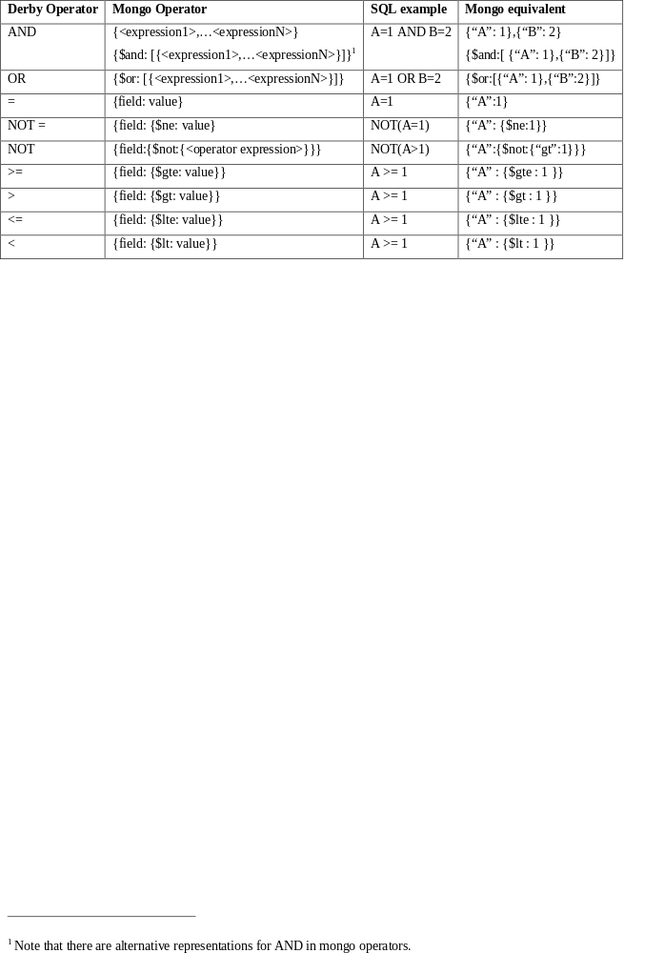
Technical Detail - “Where” clause support
All “where” clause conditions are passed to MongoDB to reduce the set of data returned.
conditions are reduced to combinations of the following operators by Derby so this is the full set of qualifiers that need to be mapped.

Slide 11
Technical Detail – Supported Type Mapping
The java mongo API returns well formed java types, so with minimal translation these can be passed to derby.
Mongo Type | DERBY Type
Double | DOUBLE
String | VARCHAR
Object | VARCHAR (string equivalent of object)
Array | VARCHAR (string equivalent of JSON array)
Binary data | Not Implemented
Object id | VARCHAR
Boolean | BOOLEAN
Date | DATE
Regular Expression | VARCHAR (string equivalent)
JavaScript | VARCHAR (string equivalent)
32-bit integer | INT
Timestamp | TIMESTAMP

Slide 12
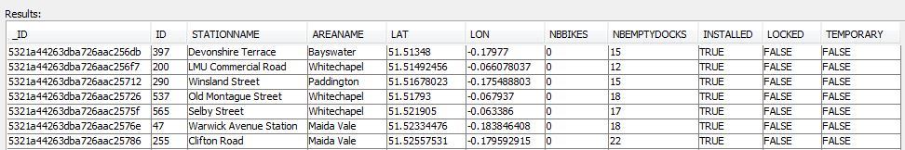
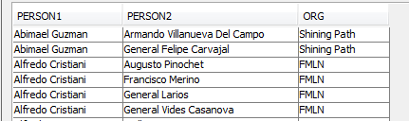
Example Queries
select * from bikes_m_n where nbbikes = 0 or areaname='Angel' and nbemptydocks> 30
select distinct P1.subjectid person1,P2.subjectid person2, p2.objectid org
from ce_all P1, ce_all P2
where p1.subjectclass='person' and p2.subjectclass='person‘ and p1.objectclass='organisation' and p2.objectclass='organisation' and p1.objectid=p2.objectid and not p1.subjectid=p2.subjectid

Slide 13
Gaian Database Asset
Accumulo VTI Design Overview

Slide 14

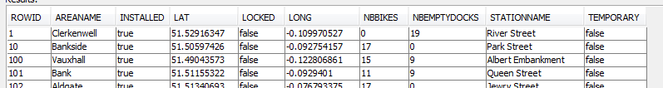
Accumulo Data Model to Logical Table Mapping
Accumulo Data Model
  Data is represented as key-value pairs, where the key and value are comprised of the following elements (see http://accumulo.apache.org/1.4/user_manual/)
Mapped to LT column “rowid”
LT column name
Possible LT
column value
Security label, LT can filter on this
Not used
Possible LT
column value
All accumulo rows with the same RowID are returned as a single Logical Table row.
  “Family” value is used as the column name
  either the “Qualifier” or “Value” can be used as the LT column value.
Logical Table format
Sample data set: London cycle hire locations
root@instance1 mytable> scan
1 areaName:col2 [] Clerkenwell
1 installed:col7 [] true
1 lat:col3 [] 51.52916347
1 locked:col8 [] false
1 long:col4 [] -0.109970527
1 nbBikes:col5 [] 0
1 nbEmptyDocks:col6 [] 19
1 stationName:col1 [] River Street
1 temporary:col9 [] false

Slide 15
Gaian Asset Accumulo VTI
Implemented
End point authentication
“Where” clause conditions (now includes all fields)
Stored Procedure “setltforAccumulo” for easy configuration
Optimised Column fetching (only queried columns are fetched)
Filter on security label expressions – configured in LT definition
Not Implemented
Caching results
Type deduction – Accumulo is a NoSQL database data types.
Advanced support for aggregate operators (count *, max, min) - will be sub-optimal.
Design Decisions
Use Java API (http://accumulo.apache.org/1.4/user_manual)
Only support for querying, not updates or inserts.
Data from Accumulo is assumed to be UTF-8 string encoded.
Testing with the last “stable” release (1.4.4). “Latest” is 1.5.1.
  (note that version 1.5 has new features, but at the start of development, the release was not stable.)
Derby
database
Query
results
Query
execution
Accumulo VTI
Connect
Query
execution
Accumulo
Server
Get results
Get datasource
configuration
GaianDB
Config

Slide 16
Configuration API procedure
The procedure must be registered before it can be used:
  CREATE PROCEDURE setltforaccumulo( ltname varchar(32672), connectorID varchar(32672), tablexpr varchar(32672) ) PARAMETER STYLE JAVA LANGUAGE JAVA MODIFIES SQL DATA EXTERNAL NAME 'com.ibm.db2j.AccumuloVTI.setLogicalTableForAccumulo’
Procedure invocation Syntax
  SQL> call setltforaccumulo (‘{Gaian logical table name}‘ , ‘{connectorID}[:{user}:{password}@{CSV list of Zookeeper hosts or IPs}/{Accumulo instance}]‘, ‘{Accumulo table name}')
  The procedure will create a logical table definition and federated data source based on AccumuloVTI and referencing the given Accumulo table name.
  The procedure requires a connectorID as second argument which points to a set of Accumulo connector properties in Gaian config. You may optionally set the properties of the connector when invoking the procedure, as specified in the syntax.
  The created data source is set to derive it’s schema from the first row in the Accumulo table. This can later be disabled by removing argument “DERIVE_SCHEMA_FROM_FIRST_ROW” from the <LTNAME>_DS0_ARGS property. Gaian will then extract columns named as in the logical table definition <LTNAME>_DEF, or you can set property <LTNAME>_DS0_SCHEMA to specify others. Use built-in API setconfigproperty() to set properties, or manually edit gaiandb_config.properties.
Examples:
  SQL> call setltforaccumulo('LTBIKES', ’ac1:root:password@10.2.3.4,zookeeper2/inst1’,’bikesTable’)
  SQL> call setltforaccumulo('LTBIKES2', ’ac1', 'myAccumuloTable2’)

Slide 17
Technical Detail – Example configuration
Example configuration in gaiandb_config.properties:
LTBIKES_DEF=ID INT, STATION VARCHAR(50), AREA VARCHAR(50), NUMBIKES INT, LAT DOUBLE, LONG DOUBLE
LTBIKES_DSACC1_VTI=com.ibm.db2j.AccumuloVTI
LTBIKES_DSACC1_ARGS=AccumuloUserInstance1, <MyAccumuloTable>
LTBIKES_DSACC1_OPTIONS=MAP_COLUMNS_BY_POSITION
# optional column mapping if not mapped by position.
[LTBIKES_DSACC1_C2=STATIONNAME]
[LTBIKES_DSACC1_C3=AREANAME]
[LTBIKES_DSACC1_C4=NBBIKES]
AccumuloVTI.AccumuloUserInstance1.INSTANCE=<MyInstanceName>
AccumuloVTI.AccumuloUserInstance1.ZOOKEEPERS=<MyZookeepers>
AccumuloVTI.AccumuloUserInstance1.USR=<MyUser>
AccumuloVTI.AccumuloUserInstance1.PWD=<MyPassword>
Multiple data source definitions can point to the same AccumuloVTI properties.
Column mappings for logical columns (C2, C3, etc) are set at the data source wrapper level, or specify: MAP_COLUMNS_BY_POSITION
The data retrieved from Accumulo is treated as UTF-8 string encoded, this will be “cast” into the types specified in the Logical Table definition.

Slide 18
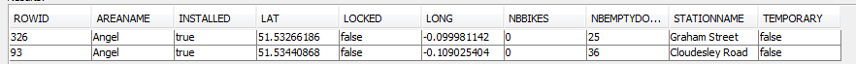
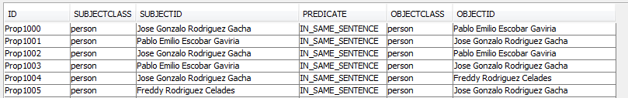
Example Queries
select * from bikes_a_all where nbbikes = '0' and areaname='Angel'
select * from ce_a_all where objectclass='person'

Slide 19
Limitation on supported data-encodings
AccumuloVTI currently only supports decoding of UTF-8 encoded strings from Accumulo Key/Value fields.
This could be extended in future, for example to allow binary encoding of numerical values, to allow efficient storage and searching on numerical data-types.

Slide 20
“Where” conditions passed to Accumulo
In SQL Queries against a logical table, any fields queried may be subject to a “where clause”, filtering the data set returned.
Conditions are applied one scan after the other, each scan reduces the set of ROW IDs that match.
  Conditions on the ROWID column are applied using Accumulo Range feature
  Conditions on other columns are applied using Accumulo RegExFilter feature
Limitation: Comparisons are not passed down to Accumulo if they are ORed with another comparison referencing another column (e.g. Name=”John” OR Address>”Bond Street”). These comparisons are applied in the AccumuloVTI itself. This does not affect the result, but we may retrieve more data from Accumulo than we would ideally like.
Future improvement (with Accumulo 1.5): New server-side Filter objects, referenced under Accumulo Iterators on the client, could possibly apply all filtering in 1 scan.
  See https://github.com/bfemiano/accumulo-hive-storage-manager
Notes:
Reduction of Accumulo results is achieved using Accumulo “Range” and “Regex Filter” mechanisms.
A “Range” condition may be applied on the ROWID column.
“Regex Filter”

Slide 21
Big Data VTIs
MongoDB and Accumulo
Demonstration Overview

Slide 22
Demo Scenario – Bikes data partitioned on rows
bikes_a
bikes_a_n
bikes_all
bikes_m_s
bikes_m
GaianDB
Logical Tables
MongoDB
Accumulo
ce_sentences_all
ce_sentences
bikesnew
bikesnorth
bikessouth
bikessref
ce/sentences
ce/sentences0
bikes/south
bikes/north
bikes/bikes
bikes/dynamic

Slide 23
Demo Scenario – Bikes data partitioned on columns
bikes_a
bikes_a_r
bikes_m_d
bikes_m
GaianDB
Logical Tables
MongoDB
Accumulo
ce_sentences_all
ce_sentences
bikesnew
bikesnorth
bikessouth
bikessref
ce/sentences
ce/sentences0
bikes/dynamic
bikes/south
bikes/north
bikes/bikes

Slide 24
Demo Scenario – CE data partitioned on rows
ce_a
ce_all
ce_m
GaianDB
Logical Tables
Accumulo
MongoDB
ce_sentences_all
ce_sentences
bikesnew
bikesnorth
bikessouth
bikessref
ce/sentences0
ce/sentences
bikes/south
bikes/north
bikes/bikes
bikes/dynamic

